Slide 1
The Frailty Challenge
Caring for Older People in the Community
Prof Martin Vernon
NCD Older People
30 September 2016

Slide 2
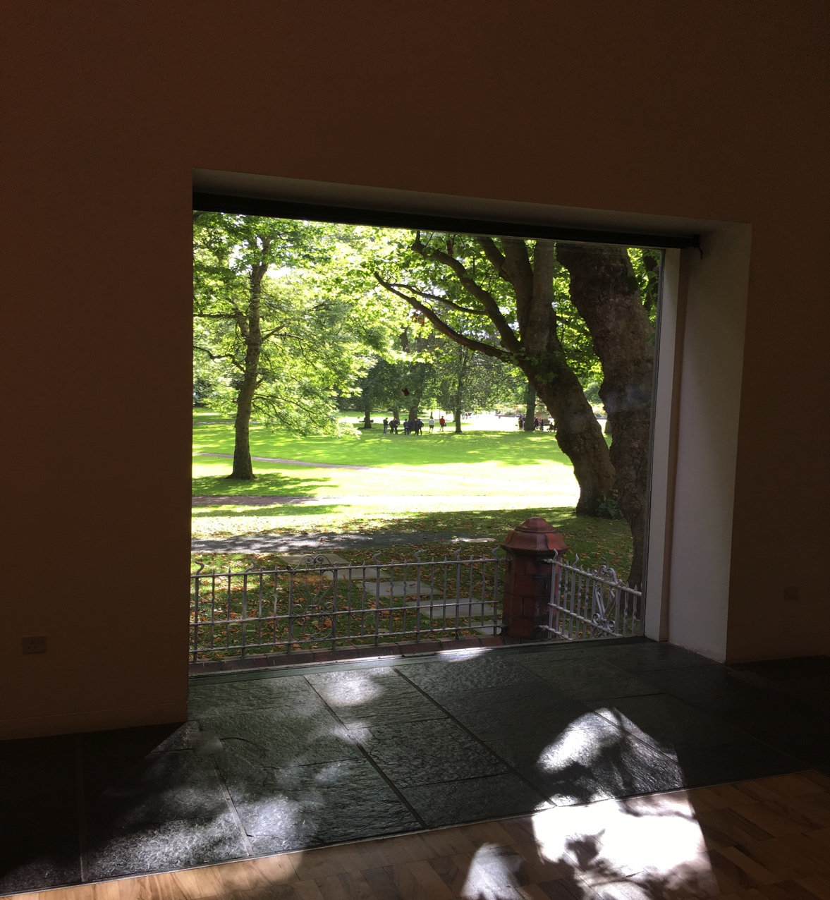
‘Its not how old we are but how we are old’

Slide 3
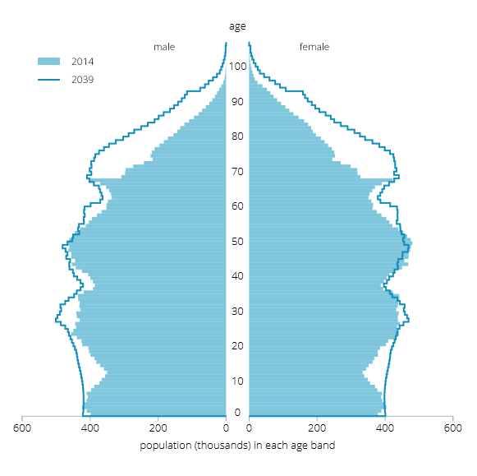
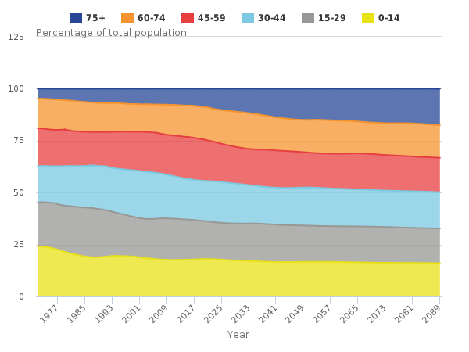
Projected UK age structure
ONS, 2015 (latest)

Slide 4
Ageing population
Older population expansion in England will accelerate next 20 years
Over 65s will ⬆ from 17% (2010) to 23% by 2035
England in 2014: 9.5 million aged 65+; 471K aged 90+
By 2035 there will be 14.5 million 65+ and 1.1 million 90+
15 million live with a long term condition (LTC)
58% people with a LTC are over 60 (14% under 40)
A&E attendances by people aged 60+ by two thirds 2007 to 2014
2010-15: 18% ⬆in emergency hospital older people admissions

Slide 5
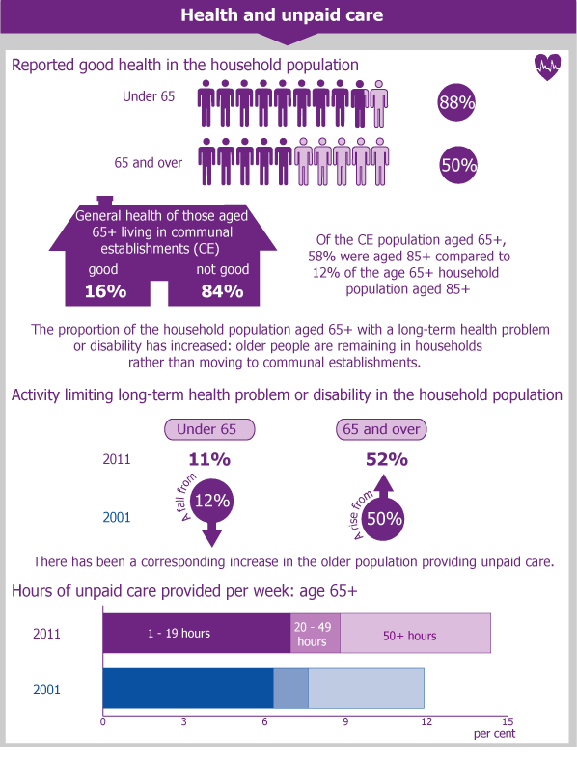
Health and unpaid care
Over 65s report poorer health and provide a growing amount of unpaid care
73% people >65 with disability receive care from a family member
‘Verticalised’ families: more generations are alive simultaneously
2007 to 2032 people >65 who require unpaid care is projected to have grown by >1 million
For people >70 the primary challenge will be maintaining physical connectivity
2011 Census & Foresight Report 2016

Slide 6
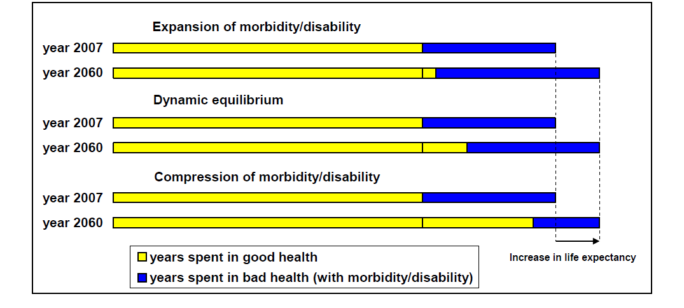
Hypotheses: evolution of healthy life expectancy

Slide 7
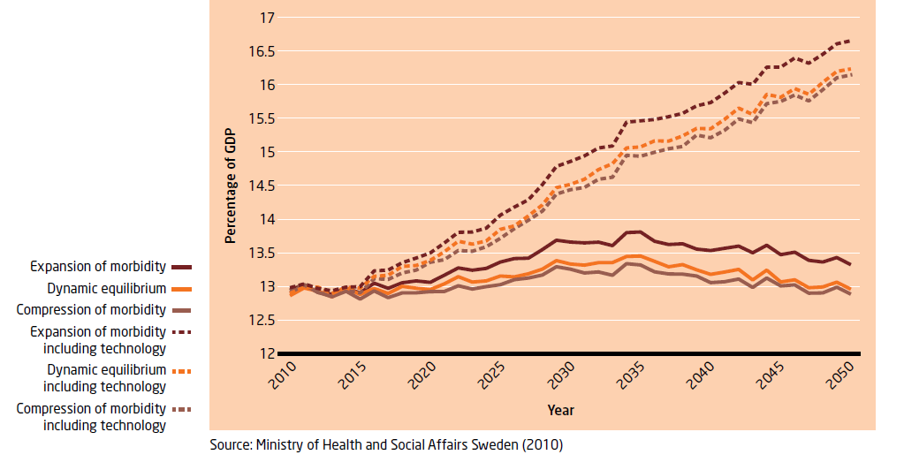
Projected spend on health & elderly care as % of GDP
3 scenarios with & without assumptions about improvements in technology

Slide 8


Slide 9
What is frailty?
A long-term condition characterised by lost biological reserves across multiple systems and vulnerability to decompensation after a stressor event
‘The most problematic expression of human ageing facing the NHS today’ (Clegg)
‘MINOR ILLNESS’
INDEPENDENT
FUNCTIONAL ABILITY
DEPENDENT
Unpredictable recovery

Slide 10
The Frailty phenotype
Not all old people are frail: not all people with frailty are old
Easily recognisable when advanced: ‘know it when you see it’
Syndrome characterised by 3 or more criteria
Unintentional weight loss (4.5kg in last year)
Self reported exhaustion
Weakness (grip strength)
Slow walking speed (<0.8 metres/second)
Low physical activity
Fried et al. J Gerontol A Biol Sci Med Sci (2001) 56 (3): M146-M157

Slide 11
The Frailty phenotype
People aged >60: 14% & those >90: 65%
More common in women (16% v 12%)
In England1.8m people >60 and 0.8M people>80 live with frailty
93% frail people have mobility problems
63% need a walking aid
71% frail people receive help
Over 3 years it is independently predictive of:
Falls
Worsening mobility or ADL disability
Hospitalisation
Death (twice as likely)
Fried et al. J Gerontol (2001) 56(3): M146-M157
Gale et al. Age Ageing 2015;44:162-165

Slide 12
Clinical Frailty Scale

Slide 13
Routine frailty identification
Distinguishing fit from frail & frail from fit…
…is the most pressing clinical task of our age
Can be achieved for individuals or populations
Frailty is linked to acquisition of multiple Long Term Conditions
Routine frailty identification in primary care has 2 potential merits:
Population risk stratification
Targeted individualised interventions for optimal outcomes

Slide 14
Simple instruments to identify frailty
 | Sensitivity | Specificity
Gait Speed <0.8m/s | 99% | 64%
Gait Speed <0.7m/s | 93% | 78%
TUGT >10s | 93% | 62%
PRISMA 7 | 83% | 83% (wide CIs)
Self-reported Health | 83% | 72% (wide CIs)
Groningen Frailty Indicator | 58% | 72%
Polypharmacy (>5 meds) | 67% | 72%
GP clinical assessment | 58% | 72%
Frailty instruments assessed against a reference standard: Clegg et al Age Ageing 2014
(Systematic Review)

Slide 15
Frailty Index (FI)
Not all people at same age have same risk of death
Deficit accumulation: more things go wrong, more likely you are to die
The index measures cumulative deficits
A person with 7/70 measureable deficits...has index score 7/70=0.1
Baseline FI>0.45 associated with 100% 7 year mortality
There is a limit to frailty of FI=0.7

Slide 16
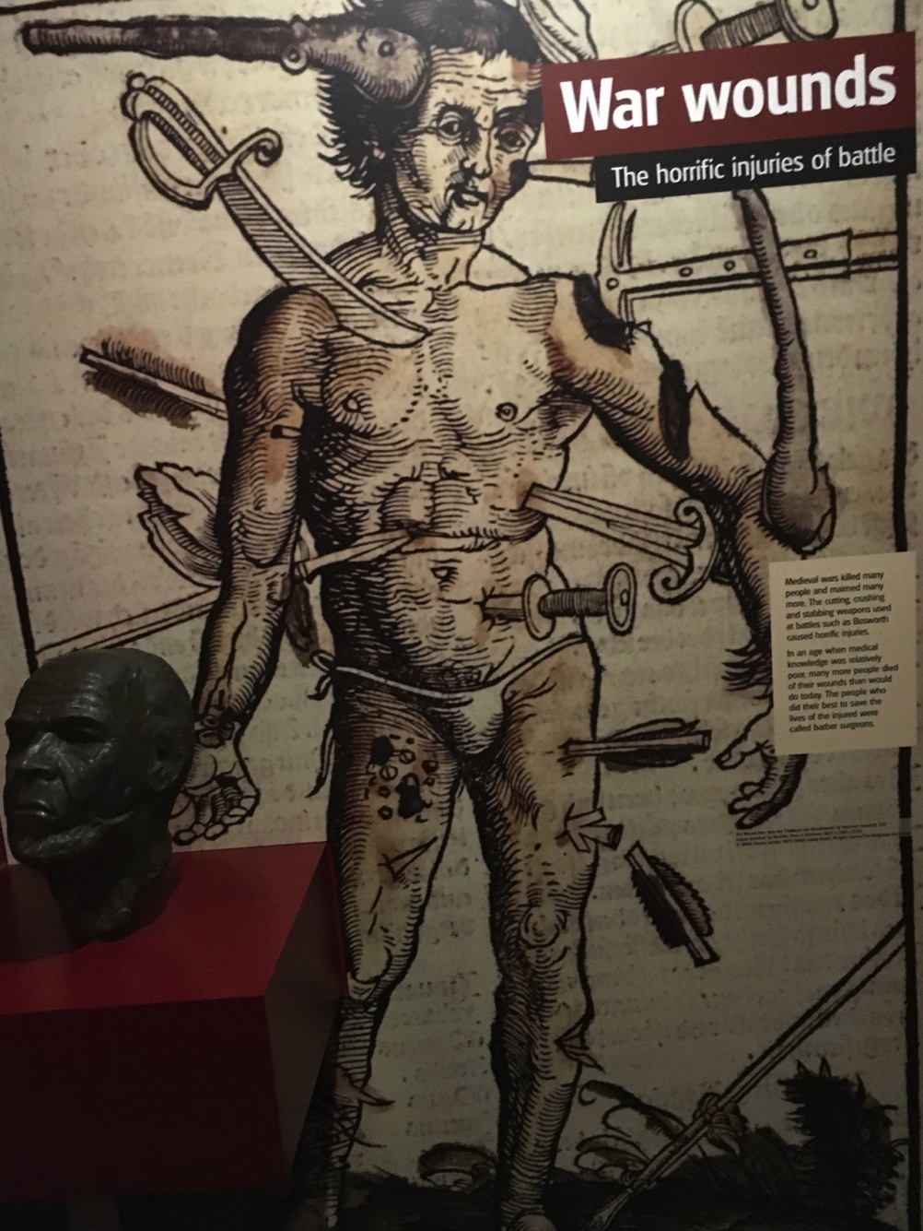
Deficit accumulation

Slide 17
Deficit accumulation
World-wide, across different data sets, using different variables
Community dwelling people accumulate deficits at about 3% per year
Can be demonstrated from age 15 onwards
CMAJ, Rockwood et al, 2011

Slide 18
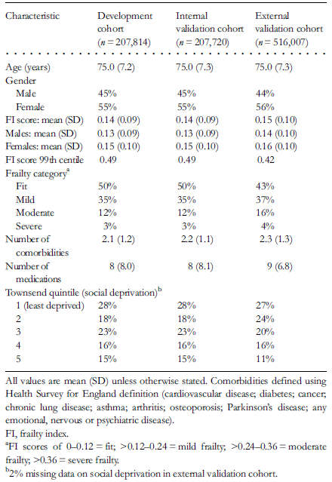
Electronic Frailty Index (eFI)
International guidelines recommend routine frailty identification
Currently available tools require additional resource and may be inaccurate
The eFI has been developed and externally validated using routine primary care data
Clegg et al Age & Ageing (2016)

Slide 19
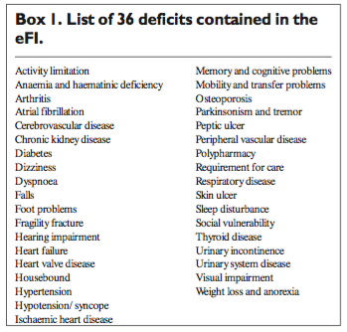
Electronic Frailty Index (eFI)
Clegg et al: Age Ageing2016: 45:353-360

Slide 20
Electronic Frailty Index (eFI)
The eFI has robust predictive validity for predicting outcomes (age 65-95)
1,3 5 year risk mortality, hospitalisation, nursing home admission
The prevalence of people who were fit, had mild, moderate or severe frailty was 43%, 37%, 16% and 4% respectively
Severe frail had on average 2.3 comorbidities and were taking 9 medications
One year risk almost doubles for mild frailty and quadruples for severe frailty
Routine implementation of the eFI could enable delivery of evidence-based interventions to modify frailty trajectories
One year outcome (hazard ratio) | Mild frailty | Moderate frailty | Severe frailty
Mortality | 1.92 | 3.1 | 4.52
Hospitalisation | 1.93 | 3.04 | 4.73
Nursing home admission | 1.89 | 3.19 | 4.76

Slide 21
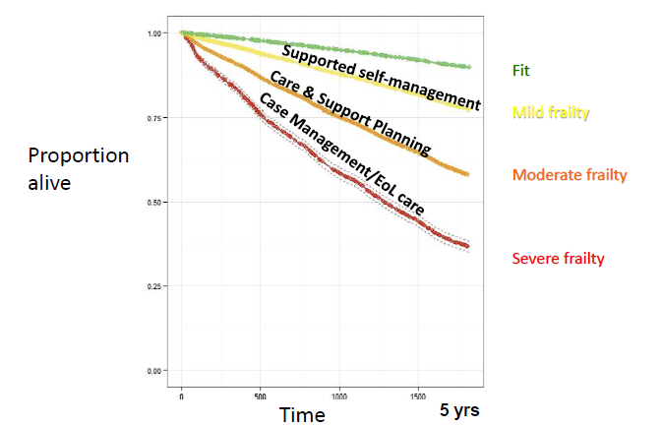
Primary care electronic Frailty Index (eFI)
Survival plots (n=227,648; >65y) (Clegg et al)

Slide 22
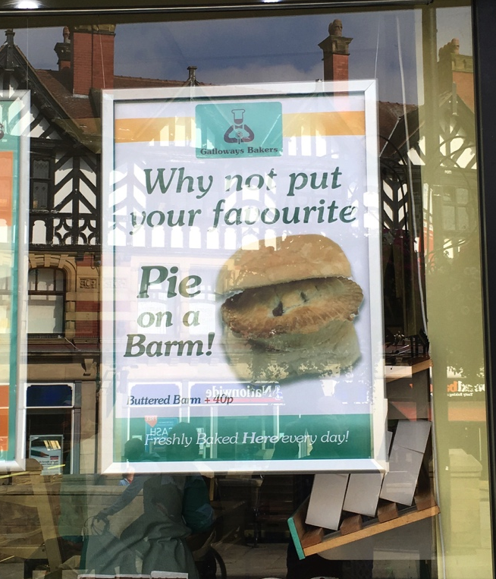
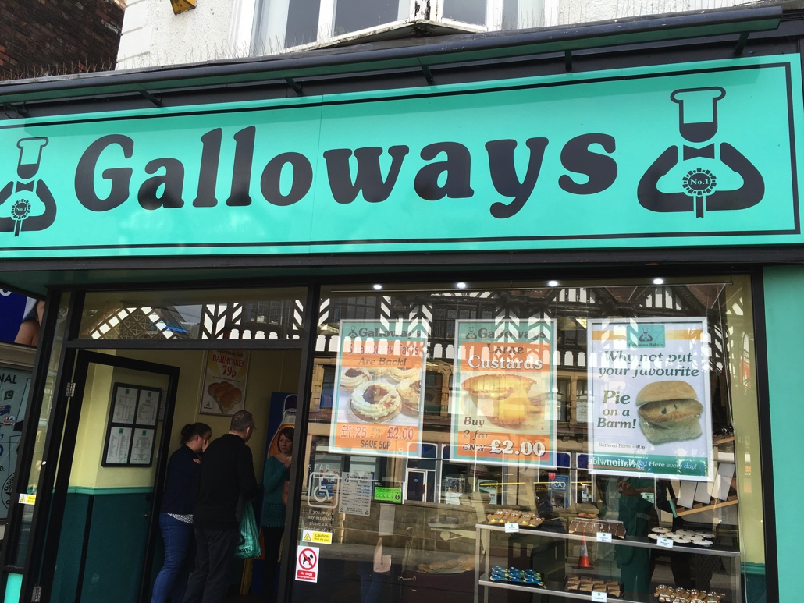
Can we use frailty for prevention?
Stuck et al. Soc Sci Med. 1999(Systematic review of 78 studies)

Slide 23
Can we use frailty for prevention?
Potentially modifiable risk factors
Alcohol excess
Cognitive impairment
Falls
Functional impairment
Hearing problems
Mood problems
Nutritional compromise
Physical inactivity
Polypharmacy
Smoking
Social isolation and loneliness
Vision problems
Targeted interventions for those at most risk :
Good foot care
Home safety checks
Vaccinations
Keeping warm
Readiness for winter
Stuck et al. Soc Sci Med. 1999(Systematic review of 78 studies)

Slide 24
Potential Frailty Interventions
CLEVELAND CLINIC JOURNAL OF MEDICINE VOLUME 72 • NUMBER 12: 2005

Slide 25
Interventions
Systematic review 2011: 98 articles; 11 met criteria*
8 high quality studies focused on improvement
6 exercise based interventions
5 showed improvement in 2 or more frailty indicators
Cochrane are in process of undertaking a systematic review
Systematic review of RCTs 2008: 89 trials, 97984 people**
Community-based multifactorial intervention in older people (mean age 65)
Interventions reduced risk of:
  Not living at home
  Nursing home admission
  Hospital admissions
  Falls
Physical function improved with intervention
*Journal of Clinical Gerontology and Geriatrics Volume 3, Issue 2 , Pages 47-52, June 2012
**Lancet 2008 (371): 725-735

Slide 26
Frailty as a Long Term Condition
Common (25-50% of people over 80 years)
Progressive (over 5 to 15 years)
Episodic deteriorations (delirium, falls, immobility)
Preventable components
Impact on quality of life
Expensive
Fit
Mild
Moderate
Severe
INCREASING FRAILTY

Slide 27
Frailty as a Long Term Condition
A long term condition can be diagnosed, is not curable but can be managed and persists
As resilience is lost, care and support planning assumes greater importance through to the end of life
PREVENTION
CARE & SUPPORT PLANNING
END OF LIFE
RESILIENCE
INCREASING FRAILTY

Slide 28
Frailty as a Long Term Condition
NOW
FUTURE
‘The frail Elderly’
‘An Older Person living with frailty’
A long-term condition
Late
Crisis presentation
Fall, delirium, immobility
Timely identification preventative, proactive care
supported self management & personalised care planning
Hospital-based episodic care
Disruptive & disjointed
Community based person centred & coordinated
Health + Social +Voluntary+ Mental Health

Slide 29

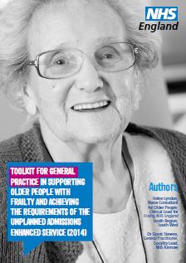
What we’ve done so far
Read codes for mild, moderate and severe frailty
Healthy Aging and Caring Guides
Handbooks for Care & Support Planning
Safe and well visits by Fire Service
Commitments to Carers
Frailty toolkit for primary care
Frailty CQUIN
Integrated pathway of care
Commitments to end of life care
Standard outcomes set for older people
Rightcare Frailty Scenario
Notes:
Healthy aging – supporting people to live well and independently for as long as possible
Risk assessment, diagnosis and registration of people at risk of, or living with, frailty
Proactive care and support – managing multi-morbidity and the trajectory of frailty as a long-term condition. Including supported self-management for people with mild frailty, and co-ordinated, person-centred care for people with multi-morbidity and/or moderate and severe frailty and support for older carers
End of life care – supporting timely, high quality, coordinated and compassionate end of life care
Delivery enablers – supporting an effective and coordinated approach to care for older people across local health economies including, for example, agreeing a standard metrics for quality and outcomes, and considering skills requirements and organisation of multi-disciplinary teams.

Slide 30
What we’re doing
Age well approach: prevention through LTC management
Promotion of electronic frailty index and additional information within summary care record
Economic modelling of impact of frailty
Ambulance and police consensus statements
Care homes commissioning guidance
Falls consensus with PHE
NICE multi-morbidity clinical guideline
Supporting winter planning and keeping well
Sustaining intermediate care data series
Notes:
Healthy aging – supporting people to live well and independently for as long as possible
Risk assessment, diagnosis and registration of people at risk of, or living with, frailty
Proactive care and support – managing multi-morbidity and the trajectory of frailty as a long-term condition. Including supported self-management for people with mild frailty, and co-ordinated, person-centred care for people with multi-morbidity and/or moderate and severe frailty and support for older carers
End of life care – supporting timely, high quality, coordinated and compassionate end of life care
Delivery enablers – supporting an effective and coordinated approach to care for older people across local health economies including, for example, agreeing a standard metrics for quality and outcomes, and considering skills requirements and organisation of multi-disciplinary teams.

Slide 31

Thank you
Notes:
Any other suggestions for what we can do (related to this work!) then email

